Slide 1
Asymmetric/ Public Key Cryptography
RSA, El Gamal, Diffie Hellman

Slide 2

Private Key Cryptography
Problem with Symmetric/ Private key cryptography is that,
We need same key
Symmetric key cryptography without extra support are virtually un-usable.
Unless you have a reliable courier, you send the key to the other person in a sealed envelope, then the other person and you can use the same key for future communication.
Issue= Key Sharing

Slide 3
Asymmetric Cryptography
Uses two keys for every simplex logical communication link
Public Key
Private Key
Simplex means link in a particular direction.
KU_{A,} KR_{A} of A and KU_{B,} KR_{B} of B
(Public Key of A) KU_{A,} (Private key of A)R_{A}
(Public Key of B) KU_{B,} (Private key of B)R_{B}
A
B
KU_{A}, KR_{A}
KU_{B}, KR_{B}

Slide 4
Asymmetric Cryptography
The use of two keys has profound consequences in the areas of
Confidentiality: but we can also have that in Symmetric Key
Key Distribution: New, we need it in current scenarios.
Authentication
Ingredients of Public Key Cryptography
Plaintext(P)
Public Key (KU) and Private Key(KR)
KU Known to every body
KR Private to you
Ciphertext (C)
Encryption Algorithm
Uses P and KU
Decryption Algorithm
Uses C and KR
The Relationship of KU and KR (Post box analogy and Diagram)

Slide 5
P, M= Plain Text , Message
C= Cipher Text
E= Encryption
D= Decryption
KU= Public Key
KR= Private Key
Sending Message from A(Source) to B (Destination).
At Source:
C= E _{KUB} (P)
At Destination:
P= D _{KRB} (C)
Notes:
RSA, EL Gamal, Elliptic Curve Cryptography etc

Slide 6
Public Key Cryptography- Authentication
Plaintext
B’s Public Key
B’s Private Key
Plaintext
A
Encryption
Algo
Decryption
Algo
B
Ciphertext
Every one can Encrypt message for me, But Only I can Decrypt the message
You want to enter your credit card no. into a form at a website, you encrypt it using public Key of B. An intruder cannot decrypt it as only B has the private key to open B
With Slight Modification this method can also be used for Authentication.
A generates any simple plaintext
Plaintext
A’s Private Key
A’s Public Key
Plaintext
A
Encryption
Algo
Decryption
Algo
B
Ciphertext

Slide 7
Applications of Public Key Cryptography
Three Categories
Encryption/Decryption
The sender encrypts, with recipient’s public Key
Digital Signatures/Authentication
Sender signs a message with its private key
Key Exchange
Two sides cooperate to exchange session key
Key Points
Computationally easy for a party B to generate a key pair
Public Key KU_{B}
Private Key KR_{B}
Easy for Sender to generate ciphertext
C = E (P, KU_{B})
Easy for Receiver to decrypt
P = D (C, KR_{B})

Slide 8

Public Key Cryptography
Key Points
Public Key system seems good but are much slower than symmetric.
I have to send 1 GB file?
Will take hours to encrypt
Use public key for exchanging symmetric key.
Computationally infeasible to determine KR_{B} knowing KU_{B.}
Computationally infeasible to recover Message M or P, knowing KU_{B} and ciphertext C.
Either of the two keys can be used for encryption, with other used for decryption

Slide 9
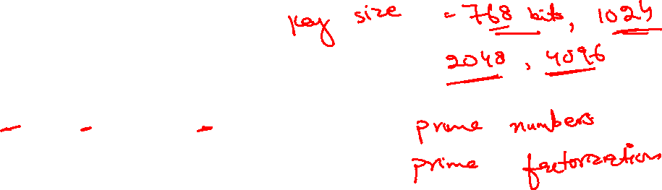
RSA Public Algorithm
Best, perhaps the only one used
Developed by Rivest, Shamir and Adleman. MIT, 1977
Block Cipher (No fixed size, up to the user)
RSA Key Generation process
Select p,q . Both ‘p’ and ‘q’ are prime
Calculate n = p * q
Calculate Φ(n) = (p-1)(q-1) where Φ(n) is the number of positive numbers less than and relatively prime to n (called Euler)
Select integer ‘e’ s.t. gcd(Φ(n) ,e) = 1 and 1 < e < Φ(n)
Calculate d = e⁻¹ mod Φ(n)
Public Key KU=(e,n)
Private key KR=(d,n)
RSA is usually used with 1024 bit keys or more
So p and q are large numbers
Plaintext M<n and n is known

Slide 10
RSA Public Algorithm
Block Cipher:
Encryption: Plaintext M<n
Ciphertext C=Me(mod n)
Decryption: Ciphertext C= M^{d}(mod n)
What we actually get is (Me)^{d} = Mde
As d and e are inverse to each other so we get M
010111111
B2
B3
B4
M<n

Slide 11
Before we move forward to RSA
There can be different schemes for encrypting a message in RSA
I mention one
Each letter in the message is represented as its ASCII code number. In ASCII, 'A' is coded as 65, 'B' is coded as 66 and so on. the message "Secret!" is coded as: 83 101 99 114 101 116 33
Each ASCII code number is then represented in binary notation using 8 bits. For this example, the binary codes become: 01010011 01100101 01100011 01110010 01100101 01110100 00100001
Each pair of characters is then assembled into blocks. This is done by taking two 8 bit numbers and representing them side by side as one 16 bit number.
In this example, there are 7 original characters that form 4 blocks: 0101001101100101 0110001101110010 0110010101110100 0000000000100001 Note that the last character is padded with zeros. Real applications of RSA use blocks of up to 8 or 16 characters each (64 or 128 bits in length).
Each message block is then represented as a decimal number that will be encrypted. For this example, the code blocks in decimal are: 21349 25458 25972 33

Slide 12
Before we move forward to RSA
RSA – An Example
Here is an example of the RSA scheme in action. I have chosen primes that are large enough to be interesting but small enough that you can do all of the arithmetic with a pen, paper and calculator.
Key Generation
p = 31 q = 23 (chosen at random, normally huge values)
n = 31*23 = 713
Φ(n) = 30*22 = 660
e = 223 (chosen at random < Φ(n) and GCD(e, Φ(n)=1)
d = 367 (computed using extended Euclids algorithm Mentioned in next Slide)
Notes:
Primes are important because the security of many encryption algorithms are based on the fact that it is very fast to multiply two large prime numbers and get the result, while it is extremely computer-intensive to do the reverse.

Slide 13
Before we move forward to RSA
Extended Eucledian Algorithms:
The extended Euclidean algorithm is an extension to the Euclidean algorithm.
Besides finding the greatest common divisor of integers a and b, as the Euclidean algorithm does, it also finds integers x and y (one of which is typically negative) that satisfy ax + by = gcd(a,b).
The extended Euclidean algorithm is particularly useful when a and b are coprime, since x is the (modular) multiplicative inverse of ‘a’ modulo ‘b’, and y is the multiplicative inverse of ‘b’ modulo ‘a’. (Depends on which value is greater)
Modular Multiplicative inverse : Given natural numbers a and n, we say that b is an inverse of a modulo n if ab ≡ 1 (mod n).
For example, 7 is an inverse of 4 (mod 9) since 4×7 ≡1 (mod 9).
Now How these inverse can be found?????Studied discrete mathematics???

Slide 14
Before we move forward to RSA
Start with two simple examples
5 and 7 are co-primes: we want inverse of 5 % 7
7 = 1.5+2
5=2.2+1
Taking reverse
7-1.5=2
5-2.2=1 , putting the value of 2 we get
5-2(7-1.5)=1
5-2.7+2.5=1
3.5-2.7=1
3.5 implies that 3 is the multiplicative inverse of 5 % 7
i.e. x is multiplicative inverse of a mod b
11 and 3 are co primes (11x+3y=1)
11=3.3+2
3=1.2+1
Taking reverse
11-3.3=2
3-1.2=1, putting value of 2
3-1(11-3.3)=1
3-1.11+3.3=1
-1.11+4.3=1
4 is the quotient of smaller alue
Thus x=-11 and y=4
4 is the (modular) multiplicative inverse of 3 mod 11

Slide 15
Before we move forward to RSA
Now a bigger example with negative quotient of smaller value 660 and 223 are coprimes 660=2.223+214 223=1.214+9 214=23.9+7 9=1.7+2 7=3.2+1 Now in inverse 660-2.223=214 223-1.214=9 214-23.9=7 | 9-1.7=2 7-3.2=1, putting value of 2 7-3.(9-1.7)=1 7-3.9+3.7=1 4.7-3.9=1 , putting value of 7 4.(214-23.9)-3.9=1 4.214-92.9-3.9=1 4.214-95.9=1, putting value of 9 4.214-95.(223-1.214)=1 4.214-95.223+95.214=1 99.214-95.223=1, putting value of 214 99.(660-2.223)-95.223=1 99.660-198.223-95.223=1 99.660-293.223=1 Now -293 is the modular multiplicative inverse of 223%660, to find exact value we do 660-293=367 is answer 367*223%660=1

Slide 16
Finding it Fast: Fermat’s Little Theorem
First Version: p is a prime and a is a number not divisible by p
a^{p-1} ≡ 1 mod p
Second Version: If p is a prime and a is any integer
a^{p} ≡ a mod p

Slide 17
Fermat’s Little Theorem
Example
Find the result of 6¹⁰ mod 11.
Solution
We have 6¹⁰ mod 11 = 1. This is the first version of Fermat’s little theorem where p = 11.
Example
Find the result of 3¹² mod 11.
Solution
Here the exponent (12) and the modulus (11) are not the same. With substitution this can be solved using Fermat’s little theorem.

Slide 18
Multiplicative Inverses Using Fermet’s Little Theorem
a⁻¹ mod p = a ^{p − 2} mod p
Because a * a⁻¹ mod p = 1 = a * a^{p-2} mod p = 1 = a^{p-1} mod p = 1 mod p
Examples
The answers to multiplicative inverses modulo a prime can be found without using the extended Euclidean algorithm (To be studied later):

Slide 19
RSA
At Side B
p = 31 q = 23 (chosen at random, could have been others)
n = 31*23 = 713
Φ(n) = 30*22 = 660
e = 223 (chosen at random, coprime of 660)
d = 367 (computed using Euclids algorithm as above)
Private key= (367,713)
Public Key= (223,713)
A want to send message = ‘439’ to B
computes c=439²²³ mod 713 = 284 (see fast exponent ion)
A sends the ciphertext 284 to B.
B receives the ciphertext 284 from A.
computes 284³⁶⁷ mod 713 = 439 (see fast exponentiation
He knows the message is 439

Slide 20
RSA: Fast Exponentiation
Suppose we need to calculate 13 ^ 7 mod 33 Note that we don't have to calculate the full value of 13 to the power 7 here. We can make use of the fact that a = bc mod n = (b mod n).(c mod n) mod n so we can break down a potentially large number into its components and combine the results of easier, smaller calculations to calculate the final value.
One way of calculating m' is as follows:- (We usually use libraries for this) Note that any number can be expressed as a sum of powers of 2. So first compute values of 13², 13⁴, 13⁸, ... by repeatedly squaring successive values modulo 33. 13² = 169 ≡ 4, 13⁴ = 4.4 = 16, 13⁸ = 16.16 = 256 ≡ 25. Then, since 7 = 4 + 2 + 1, we have m' = 13⁷ = 13⁽⁴⁺²⁺¹⁾ = 13⁴.13².13¹ ≡ 16 x 4 x 13 = 832 ≡ 7 mod 33
Any value can be written in as powers of 2
11=8+2+1
39= 32+4+2+1
1048=1024+16+8

Slide 21

RSA Public Algorithm:Example
Two prime numbers, p=7, q=17
Calculate n = pq = 7 * 17 = 119
Φ(n) = (p-1)(q-1) = 96
Select e such that e is relatively prime to 96 and less than Φ(n) , suppose e = 5
Determine d
D=77 because 77*5= 385= 4*96+1
Public Key KU={5,119)
Private Key KR={77,119}
Say plaintext M = 19
C=19⁵(mod 119) = 66
Decryption: M=66⁷⁷(mod 119) = 19

Slide 22
The Security of RSA
RSA is secure since
We use large number of bits in e and d
The problem of factoring n into two prime factors is computationally very difficult
Because n = p * q where p and q are 300 digit numbers(1024 bit), product is even bigger
It has been found in a reasonable amount of time whether a number is prime or not.
But In this case crackers have to find prime factors of a very big number
Knowing p and q will allow intruders to know the value of Φ(n)
Thus value of e and d will also be found
Key sizes in the range of 1024 to 2048 bits seem safe
Until recently around 300 bits were felt to be safe
A worldwide team cooperating over the internet cracked 300 bits in over eight months using 1600 computers.
1024 is considered safe for almost every application
Notes:
Primes are important because the security of many encryption algorithms are based on the fact that it is very fast to multiply two large prime numbers and get the result, while it is extremely computer-intensive to do the reverse.

Slide 23
El-gamal Encryption
Lets Review this for the sake of understanding the Threshold Cryptography.
Alice selects a large prime no p and e₁ s.t. (e₁ >1 and e₁ <p)
Alice selects a random number ‘d’ s.t. d>=1 and d<p
Alice calculates e₂ = e₁ ^{d} mod p
His public key is (e₁, e₂,p) while his private key is ‘d’
To Encrypt a message ‘m’ Bob Selects a random number ‘r’
Bob calculates B= e₁ ^{r} mod p and c= e₂ ^{r} * m mod p and sends
The CipherText is (B,c)
To Decrypt Alice Calculates m= (B^{d})⁻¹ *c mod p

Slide 24
El-gamal Encryption
Remember that m=(B ^{d})⁻¹ * c= (e₁ ^{dr})⁻¹ * (e₂ ^{r}) * m = (e₁ ^{dr})⁻¹ * (e₁ ^{dr}) * m
E.g. Let p =23 and e₁ =5 is selected by Alice with the value of ‘d’ being 6
She calculates e₂ =5⁶ mod 23 = 8
Her Private key now is 6 and the public keys are (5,8,23)
Bob Wants to Encrypt the Message m =12
He selects r=3 and calculates B=5³ mod 23 = 10
He calculates c=8³.12 = 3 and sends the ciphertext (10,3) to Alice
Alice calculates (10⁶)⁻¹= 4 mod 23and P=4*3 mod 23= 12

Slide 25
Diffie-Hellman Key Exchange
RSA can be used for key exchange as well but Diffie-Hellman is also used.
Proposed in 1976
Allows group of users to agree on secret key over insecure channel
No Encryption is required.
Even if intruder gets the numbers, they wont be able to know the key
Secruity depends for its effectiveness on the difficulty of computing “Discrete logarithms”
A and B want to agree on a secret key
They agree on two large numbers g and n
A chooses a random number x and computes X
X=g^{x} mod n and sends X to B
B chooses a random number y and computes Y
Y=g^{y} mod n and sends Y to A
A computes K₁= Y^{x} mod n
B computes K₂= X^{y} mod n
K₁=K₂=g^{xy} mod n
Secret key is same
A
B
_{n,g,X,Y}
I
_{n,g,X,Y}

Slide 28
Diffie-Hellman Key Exchange
Intruder doesn’t know about x,y and finding the value of x or y from Y=g^{y} mod n for intruder in reasonable amount of time is not possible.
X = g^{x} mod n is Discrete logarithm problem
This method requires no prior communication between A and B
Security depends on difficulty of computing x and y
Choices for g and n are critical
Both n and (g-1)/2 should be prime
Example: g=7, n=13 (remember actually very large numbers)
Suppose A selects x=4 and computes X= 7^4 mod 13= 9 and sends to B
Suppose B selects y=2 and computes Y=7^2 mod 13=10 and send to B
A calculates 10^4 mod 13=3 , The Key
B calculates 9^2 mod 13= 3, The common key
Remember x and y aren't small either
Susceptible to Intruder in the middle attack
Cuts A from the network and takes hold of communications with B

Slide 29
Public shared g, n, X, Y
Alice Key =a
Bob key = b
Alice g^a mod n=X -> bob
Bob g^b mod n=Y ->Alice
Alice (g^b mod n)^a mod n =g^ab mod n
Bob (g^a mod n)^b mod n= g^ab mod n

Slide 30
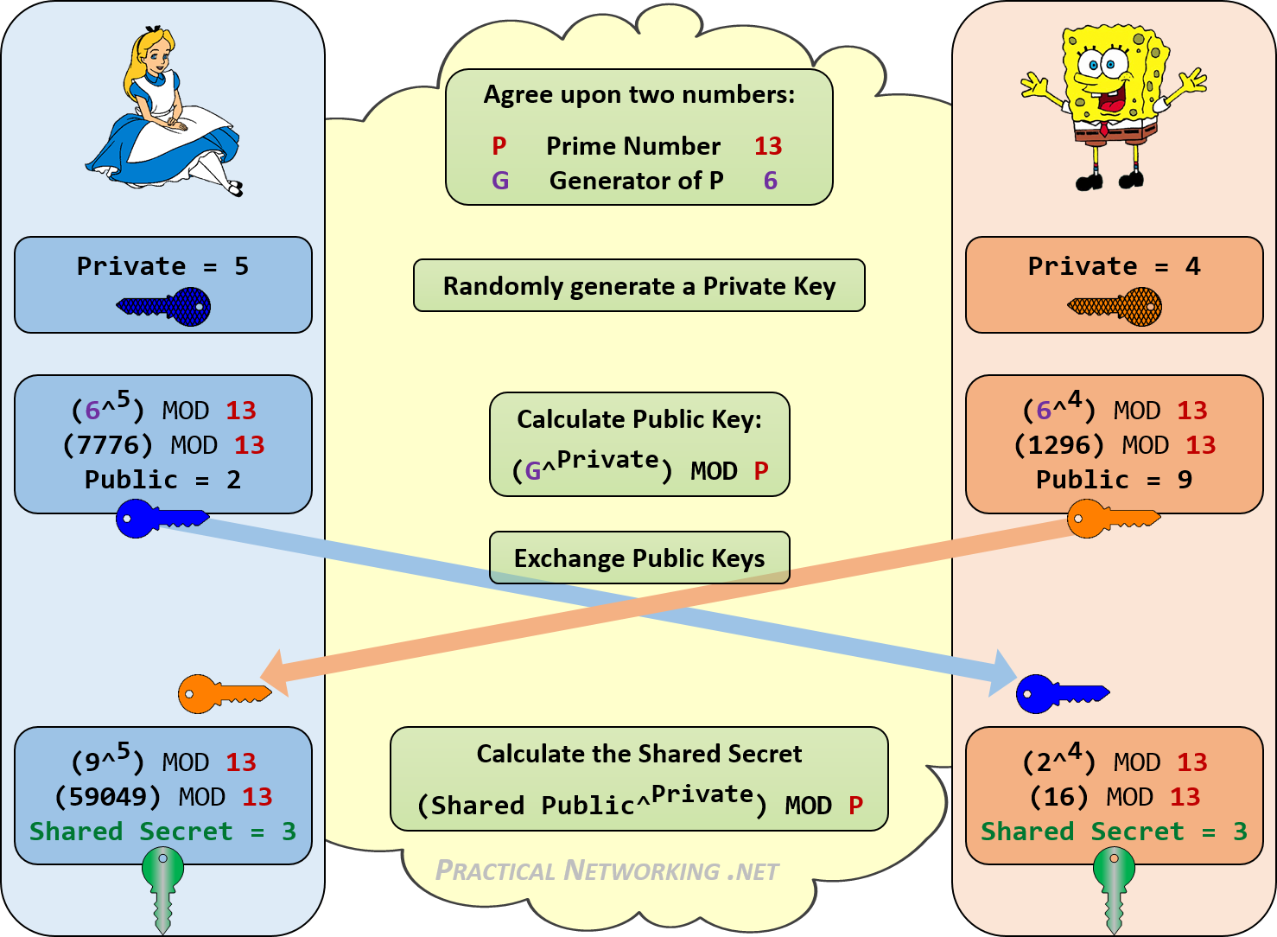

Slide 31
Discrete Logarithm Problem
Given n, g and X = g^{x} mod n, determine x
If we can do it in reasonable amount of time then this would break Diffie-Hellman
Basically have to compute g¹ mod n, g² mod n, g³ mod n,…………..Keep on doing it until you find the match.
If p were a prime of at least 300 digits (1024 bits), and a and b were at least 100 digits long, then even the best algorithms known today could not find a given only g, p, g^{b} mod p and gª mod p, even using all of mankind's computing power.
Note that g need not be large at all, and in practice is usually either 2 or 5.

Slide 32
Applications
Many protocol uses Diffie-Hellman algorithm to enhance security and few of them are:
Secure Shell (SSH)
Transport Layer Security (TLS) / Secure Sockets Layer (SSL)
Public Key Infrastructure (PKI)
Internet Key Exchange (IKE)
Internet Protocol Security (IPSec)

Slide 33
Limitations
The following are the limitations of Diffie-Hellman algorithm:
Lack of authentication procedure.
Algorithm can be used only for symmetric key exchange.
As there is no authentication involved, it is vulnerable to man-in-the-middle attack.
As it is computationally intensive, it is expensive in terms of resources and CPU performance time.
Encryption of information cannot be performed with the help of this algorithm.
Digital signature cannot be signed using Diffie-Hellman algorithm.

Slide 34

Food for Thought
Differences between RSA and Diffie Hellman?
Use cases?
Which one is better?
Should they be used to encrypt messages or just key exchange? Why?
Notes:
Factorization and Discrete log problem, Digital Signature and encryption

Slide 35
Comparison
Symmetric Encryption/Decryption is faster than asymmetric
RSA: Kb/s
DES: Mb/s
DES is about 100 times faster
Key Size:
RSA: Selected by the user
DES: 56 bits

Slide 36
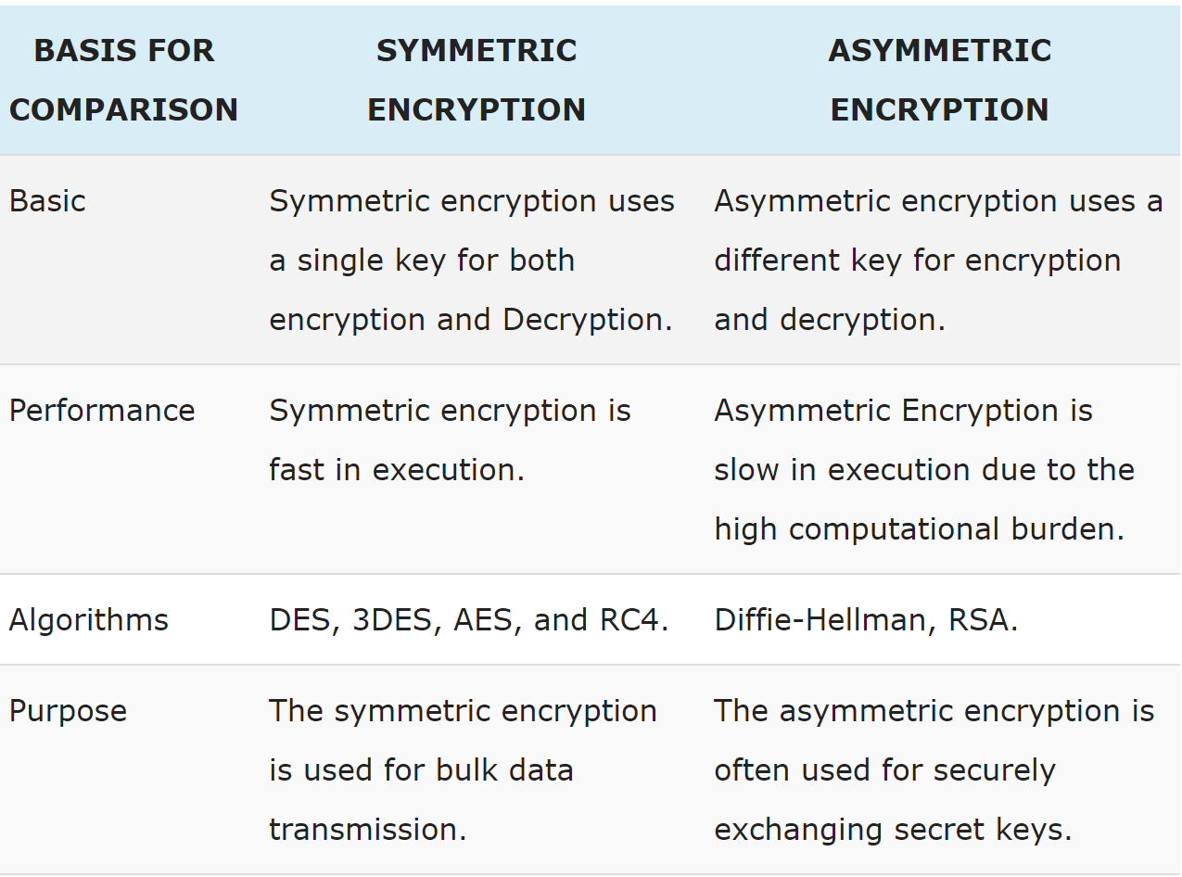

Slide 37
References
https://www.venafi.com/blog/how-diffie-hellman-key-exchange-different-rsa
https://securityboulevard.com/2020/05/types-of-encryption-5-encryption-algorithms-how-to-choose-the-right-one/

